Slide 1
Chapter 13
LIQUIDS

Slide 2
This lecture will help you understand:
Pressure
Pressure in a Liquid
Buoyancy in a Liquid
Archimedes’ Principle
What Makes an Object Sink or Float
Flotation
Pascal’s Principle

Slide 3
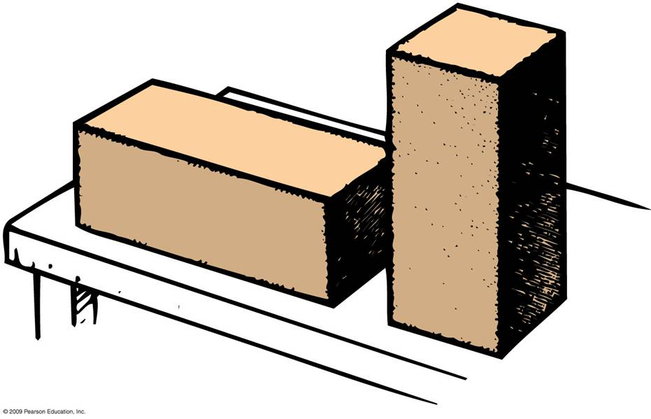
Pressure
Pressure is a force divided by the area over which the force is exerted.
Pressure = Force / Area
Which block exerts more pressure on the table?
Units: N/m², lb/ft², or Pa (Pascals)
A
B

Slide 4
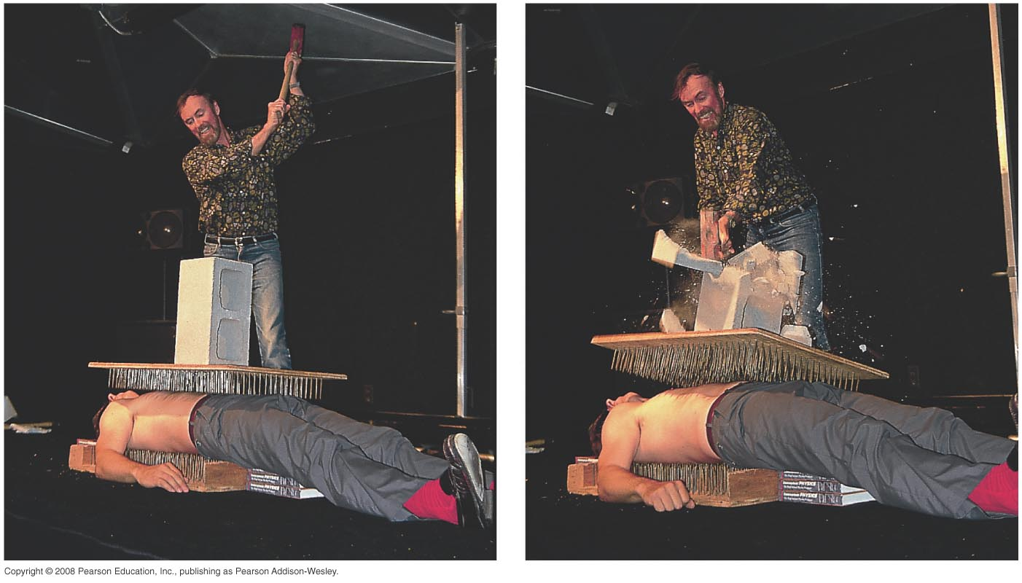
Pressure
Example: The teacher between nails is unharmed because force is applied over many nails. Combined surface area of the nails results in a tolerable pressure that does not puncture the skin.

Slide 5
When you stand on one foot instead of two, the force you exert on the floor is
A. less.
the same.
more.
None of the above.

Slide 6
When you stand on one foot instead of two, the force you exert on the floor is
A. less.
the same.
more.
None of the above.
Comment:
Distinguish between force and pressure!

Slide 7
When you stand on one foot instead of two, the pressure you exert on the floor is
A. less.
the same.
more.
None of the above.

Slide 8
When you stand on one foot instead of two, the pressure you exert on the floor is
A. less.
the same.
more.
None of the above.
Explanation:
Twice as much, in fact!

Slide 9
Pressure in a Liquid
Force per unit area that a liquid exerts on an object.
Depth dependent and not volume dependent.
Example: Swim twice as deep, then twice as much weight of water above you produces twice
as much pressure on you.

Slide 10
Pressure in a Liquid
Depends on the density of the liquid.
The depth or the weight of the water above you.
Liquid pressure = Weight density x Depth (N/m²)
Total pressure of a liquid at a given depth is the pressure of the atmosphere plus the pressure of the liquid at that depth.
Liquids are almost incompressible.

Slide 11
Pressure in a Liquid
Acts equally in all directions
Example:
  Your ears feel the same amount of pressure under water no matter how you tip your head.
  Bottom of a boat is pushed upward by water pressure.
  Pressure acts upward when pushing a beach ball under water.

Slide 12
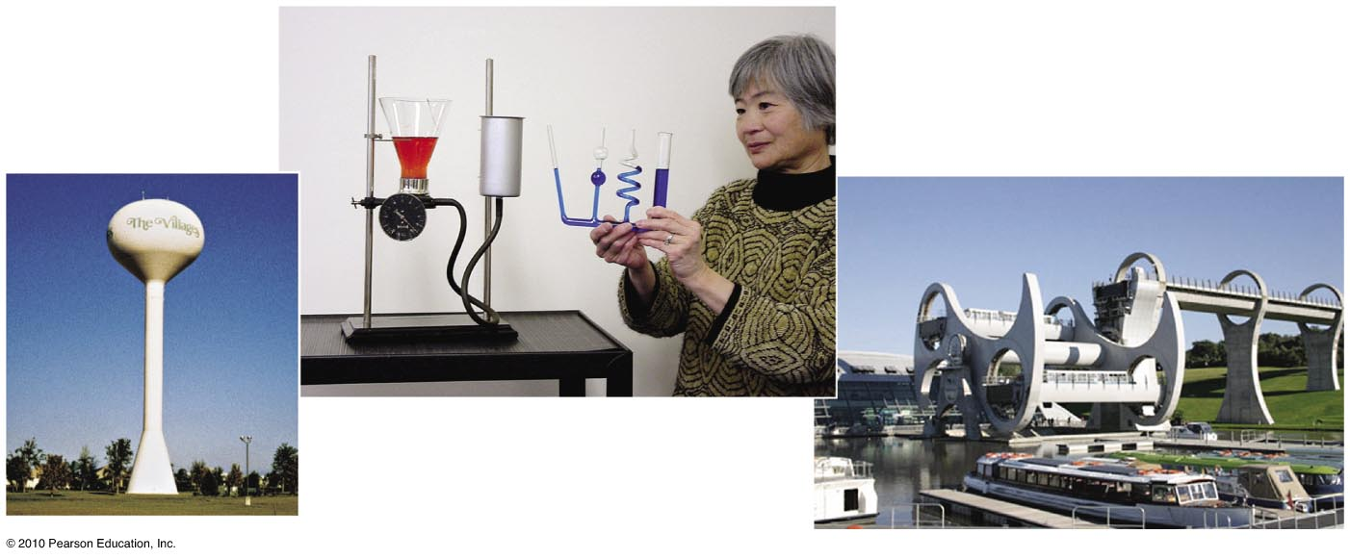
Pressure in a Liquid
Independent of shape of container:
Whatever the shape of a container, pressure at any particular depth is the same.
In equation form:
Liquid pressure = weight density × depth

Slide 13
Water pressure provided by a water tower is greater if the tower
A. is taller.
holds more water.
Both A and B.
None of the above.

Slide 14
Water pressure provided by a water tower is greater if the tower
A. is taller.
holds more water.
Both A and B.
None of the above.
Explanation:
Only depth, not amount of water, contributes to pressure.

Slide 15
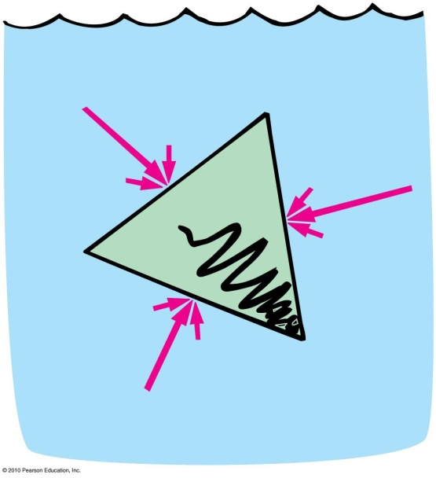
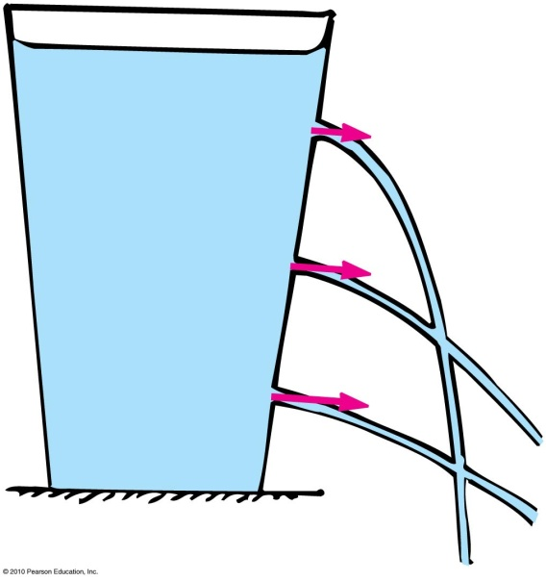
Pressure in a Liquid
Effects of water pressure
Acts perpendicular to surfaces
of a container
Liquid spurts at right angles from a hole in the surface.
  The greater the depth, the greater the exiting speed.

Slide 16
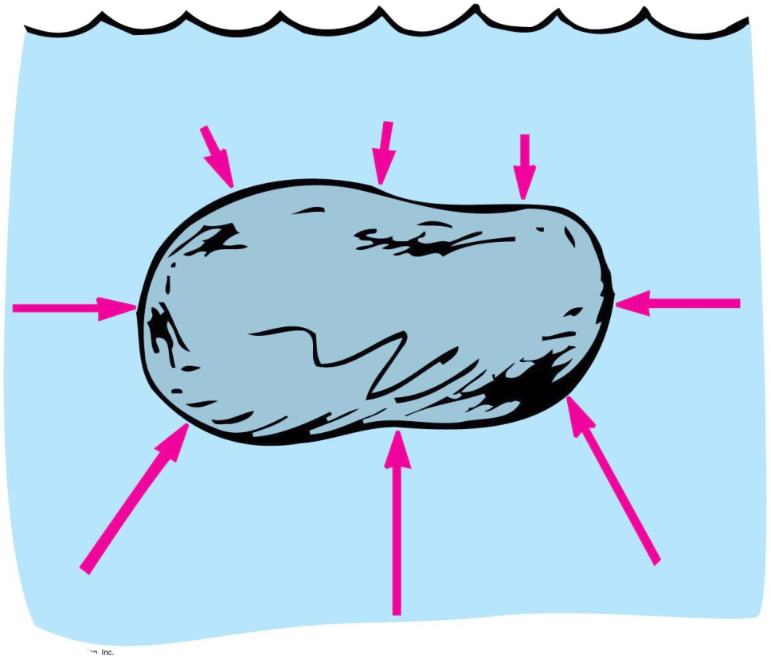
Buoyancy in a Liquid
Buoyancy
Apparent loss of weight of a submerged object
Amount equals the weight of water displaced

Slide 17
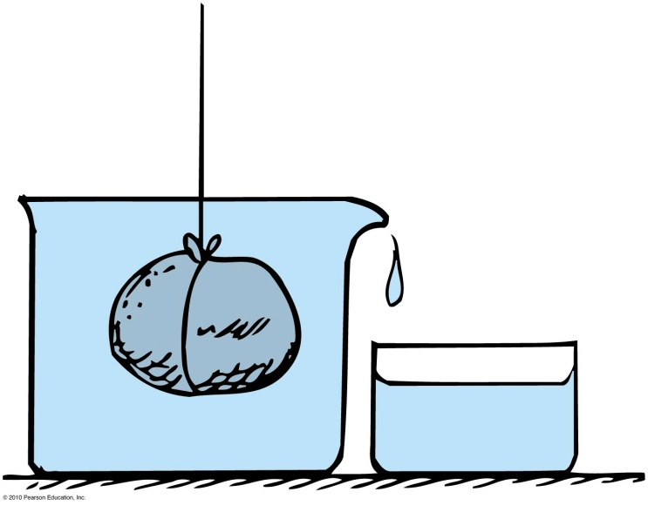
Buoyancy in a Liquid
Displacement rule:
  A completely submerged object always displaces a volume of liquid equal to its own volume.
  Example: Place a stone in a container that is brimful of water, and the amount of water overflow equals the volume of the stone.

Slide 18
A cook who measures a specific amount of butter by placing it in a measuring cup with water in it is using the
A. principle of buoyancy.
displacement rule.
concept of density.
All of the above.

Slide 19
A cook who measures a specific amount of butter by placing it in a measuring cup with water in it is using the
A. principle of buoyancy.
displacement rule.
concept of density.
All of the above.

Slide 20
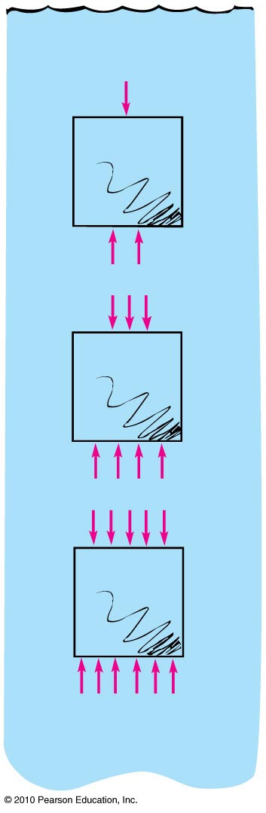
Buoyancy in a Liquid
Buoyant force
Net upward force that a fluid exerts on an immersed object = weight of water displaced
Example: The difference in the upward and downward forces acting on the submerged block is the same at any depth

Slide 21
How many forces act on a submerged body at rest in a fluid?
A. One—buoyancy
Two—buoyancy and the force due to gravity
None—in accord with the equilibrium rule, ΣF = 0
None of the above.

Slide 22
How many forces act on a submerged body at rest in a fluid?
A. One—buoyancy
Two—buoyancy and the force due to gravity
None—in accord with the equilibrium rule, ΣF = 0
None of the above.

Slide 23
Buoyancy in a Liquid
Sink or float?
Sink when weight of submerged object is greater than the buoyant force.
Neither sink nor float when weight of a submerged object is equal to buoyant force—object will remain at any level.
Float when weight of submerged object is less than the buoyant force it would have when submerged.
When floating, buoyant force = weight of floating object.

Slide 24
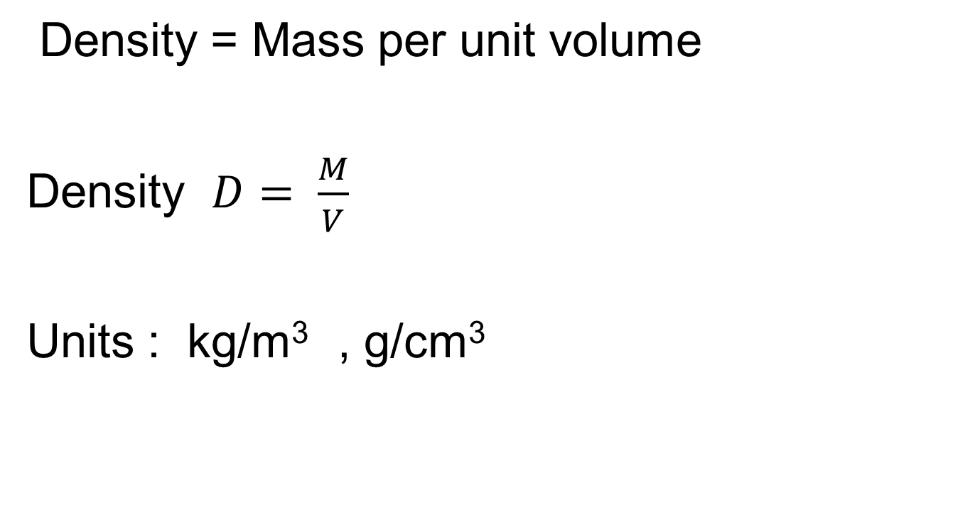
Density

Slide 25
Archimedes’ Principle
Archimedes’ principle:
Discovered by Greek scientist Archimedes.
Relates buoyancy to displaced liquid.
States that an immersed body (completely or partially) is buoyed up by a force equal to the weight of the fluid it displaces.
Applies to gases and liquids.

Slide 26
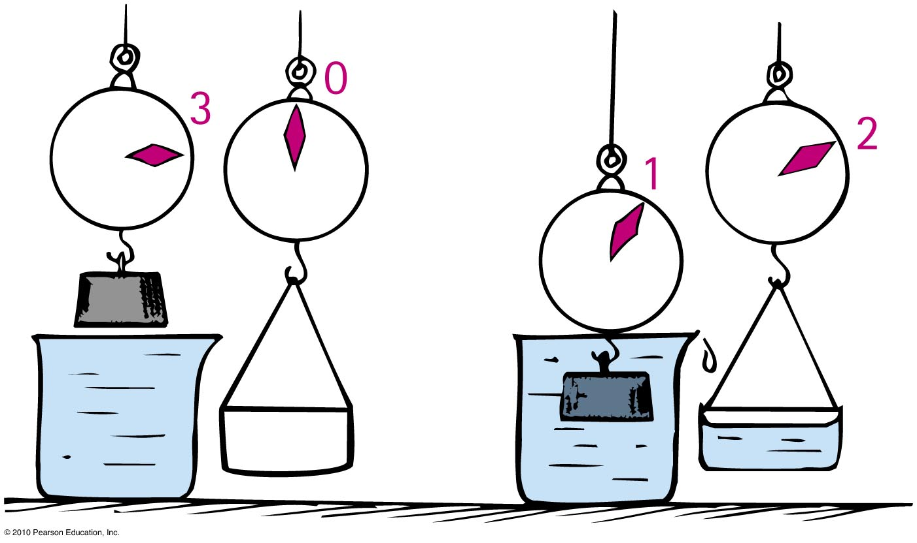
Archimedes’ Principle
Apparent weight of a submerged object
Weight out of water — buoyant force
Example: If a 3-kg block submerged in water apparently “weighs” 2 kg, then the buoyant force or weight of water displaced is 1 kg.

Slide 27
When a fish expands its air bladder, the density of the fish
A. decreases.
increases.
remains the same.
None of the above.

Slide 28
When a fish expands its air bladder, the density of the fish
A. decreases.
increases.
remains the same.
None of the above.

Slide 29
When a fish makes itself less dense, the buoyant force on it
A. decreases.
increases.
remains the same.
None of the above.

Slide 30
When a fish makes itself less dense, the buoyant force on it
A. decreases.
increases.
remains the same.
None of the above.

Slide 31
When a fish decreases the size of its air bladder, the density of the fish
A. decreases.
increases.
remains the same.
None of the above.

Slide 32
When a fish decreases the size of its air bladder, the density of the fish
A. decreases.
increases.
remains the same.
None of the above.

Slide 33
When a submarine takes water into its ballast tanks, its density
A. decreases.
increases.
remains the same.
None of the above.

Slide 34
When a submarine takes water into its ballast tanks, its density
A. decreases.
increases.
remains the same.
None of the above.

Slide 35
When a submerged submarine expels water from its ballast tanks, its density
A. decreases.
increases.
remains the same.
None of the above.

Slide 36
When a submerged submarine expels water from its ballast tanks, its density
A. decreases.
increases.
remains the same.
None of the above.
Explanation:
This is how a submerged submarine is able to surface.

Slide 37
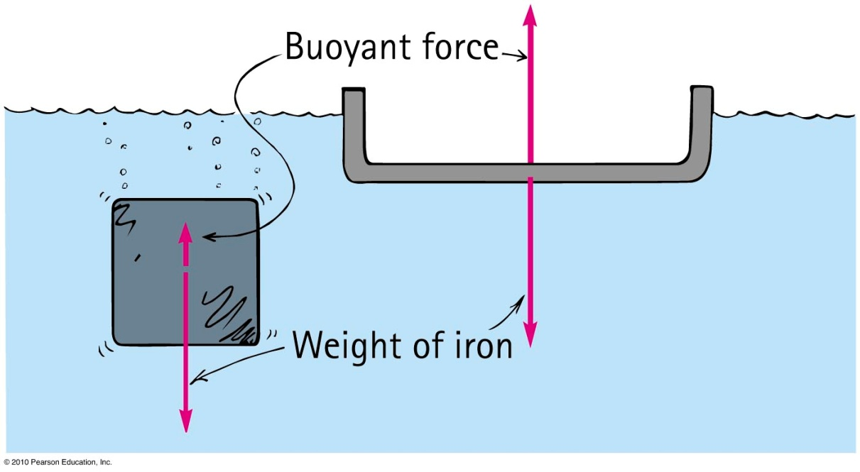
Archimedes’ Principle
Flotation
Principle of flotation:
  A floating object displaces a weight of fluid equal to its own weight.
  Example: A solid iron 1-ton block may displace 1/8 ton of water and sink. The same 1 ton of iron in a bowl shape displaces a greater volume of water—the greater buoyant force allows it to float.

Slide 38
The reason a person finds it easier to float in saltwater compared with freshwater is that in saltwater
A. the buoyant force is greater.
a person feels less heavy.
Neither of these.
None of the above.

Slide 39
The reason a person finds it easier to float in saltwater compared with freshwater is that in saltwater
A. the buoyant force is greater.
a person feels less heavy.
Neither of these.
None of the above.
Explanation:
A floating person has the same buoyant force whatever the density of water. A person floats higher because a smaller volume of the denser saltwater is displaced.
Notes:
C. neither of these.

Slide 40
On a boat ride, the skipper gives you a life preserver filled with lead pellets. When he sees the skeptical look on your face, he says that you’ll experience a greater buoyant force if you fall overboard than your friends who wear Styrofoam-filled preservers.
A. He apparently doesn’t know his physics.
He is correct.

Slide 41
On a boat ride, the skipper gives you a life preserver filled with lead pellets. When he sees the skeptical look on your face, he says that you’ll experience a greater buoyant force if you fall overboard than your friends who wear Styrofoam-filled preservers.
A. He apparently doesn’t know his physics.
He is correct.
Explanation:
He’s correct, but what he doesn’t tell you is you’ll drown! Your life preserver will submerge and displace more water than those of your friends who float at the surface. Although the buoyant force on you will be greater, the net force downward is greater still!

Slide 42
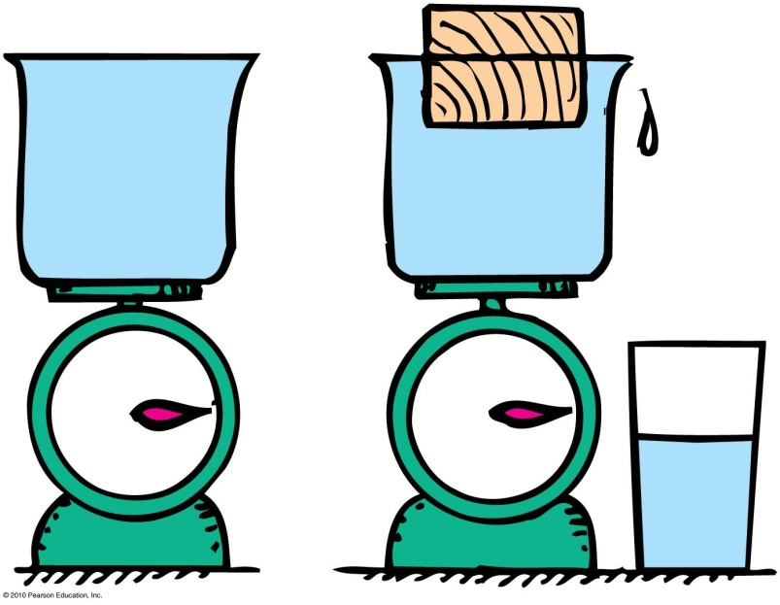
You place an object in a container that is full to the brim with water on a scale. The object floats, but some water spills out. How does the weight of the object compare with the weight of the water displaced?
A. Weight of object is greater than weight of water displaced.
Weight of object is less than weight of water displaced.
Weight of object is equal to weight of water displaced.
There is not enough information to decide.

Slide 43

You place an object in a container that is full to the brim with water on a scale. The object floats, but the water spills out. How does the weight of the object compare with the weight of the water displaced?
A. Weight of object is greater than weight of water displaced.
Weight of object is less than weight of water displaced.
Weight of object is equal to weight of water displaced.
There is not enough information to decide.

Slide 44
Archimedes’ Principle
Denser fluids will exert a greater buoyant force on a body than less dense fluids of the same volume.
Example: Ship will float higher in saltwater
(density = 1.03 g/cm³) than in freshwater (density = 1.00 g/cm³).

Slide 45
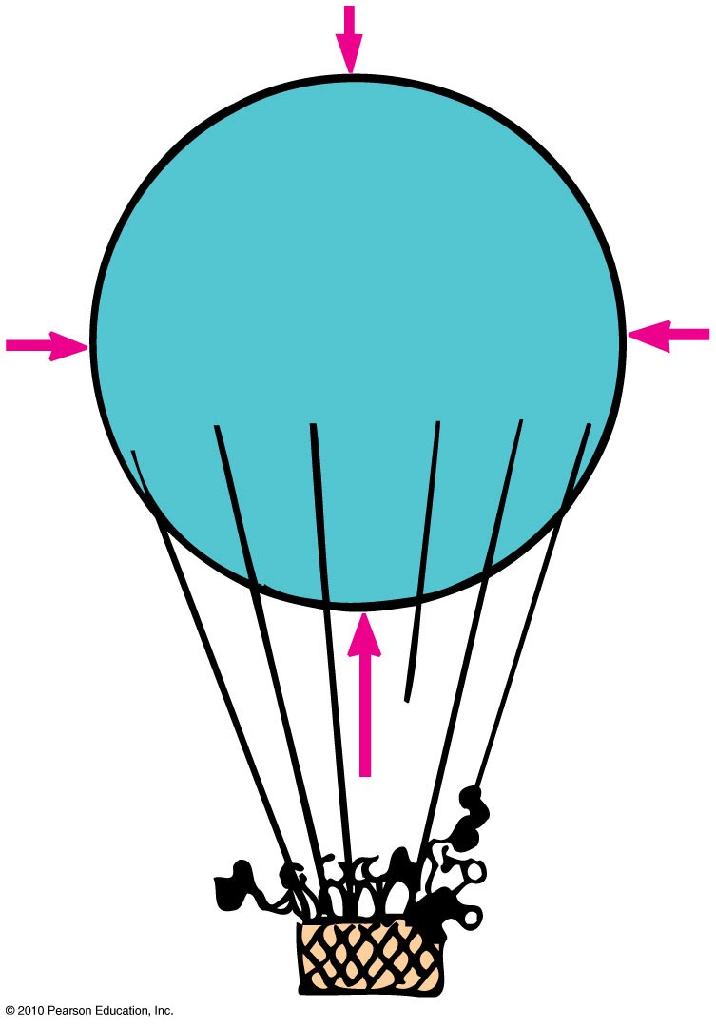
Archimedes’ Principle
Applies in air
  The more air an object displaces, the greater the buoyant force on it.
  If an object displaces its weight, it
  hovers at a constant altitude.
  If an object displaces less air, it
  descends.

Slide 46
As you sit in class, is there a buoyant force acting on you?
A. No, as evidenced by an absence of lift
Yes, due to displacement of air

Slide 47
As you sit in class, is there a buoyant force acting on you?
A. No, as evidenced by an absence of lift
Yes, due to displacement of air
Explanation:
There is a buoyant force on you due to air displacement, but much less than your weight.

Slide 48
What Makes an Object Float or Sink?
Whether an object floats or sinks depends upon the
volume of the object.
volume of the fluid displaced.
For an object to float:
Weight of object is less than buoyant force of the liquid, i.e., less than the weight of the liquid it displaces.

Slide 49
What Makes an Object Float or Sink?
Three rules:
An object more dense than the fluid in which it is immersed will sink.
An object less dense than the fluid in which it is immersed will float.
An object having a density equal to the density of the fluid in which it is immersed will neither sink nor float.

Slide 50
Two solid blocks of identical size are submerged in water. One block is lead and the other is aluminum. Upon which is the buoyant force greater?
A. On the lead block
On the aluminum block
Same on both blocks
There is not enough information to decide.

Slide 51
Two solid blocks of identical size are submerged in water. One block is lead and the other is aluminum. Upon which is the buoyant force greater?
A. On the lead block
On the aluminum block
Same on both blocks
There is not enough information to decide.
Explanation:
The buoyant force depends upon the volume of the block that is submerged. Since both submerged blocks are the same size, they displace the same volume of water. So they have the same buoyant force.

Slide 52
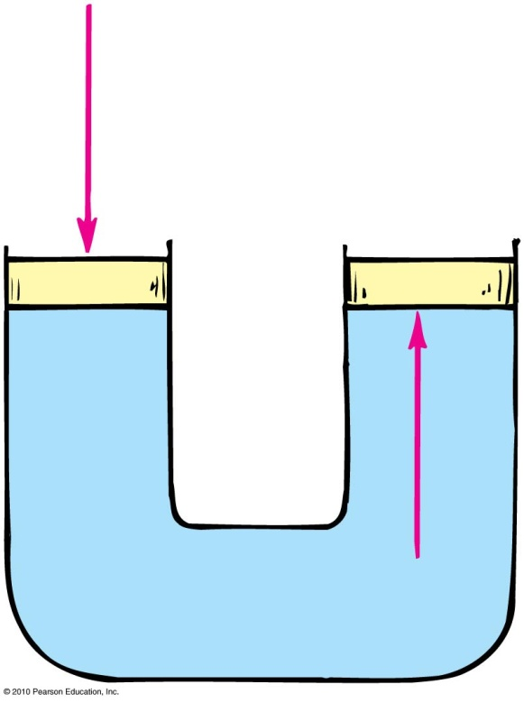
Pascal’s Principle
Pascal’s principle:
Discovered by Blaise Pascal, a scientist and theologian in the 17th century
States that a change in pressure at any point in an enclosed fluid at rest is
transmitted undiminished to
all points in the fluid
Applies to all fluids—gases
and liquids

Slide 53
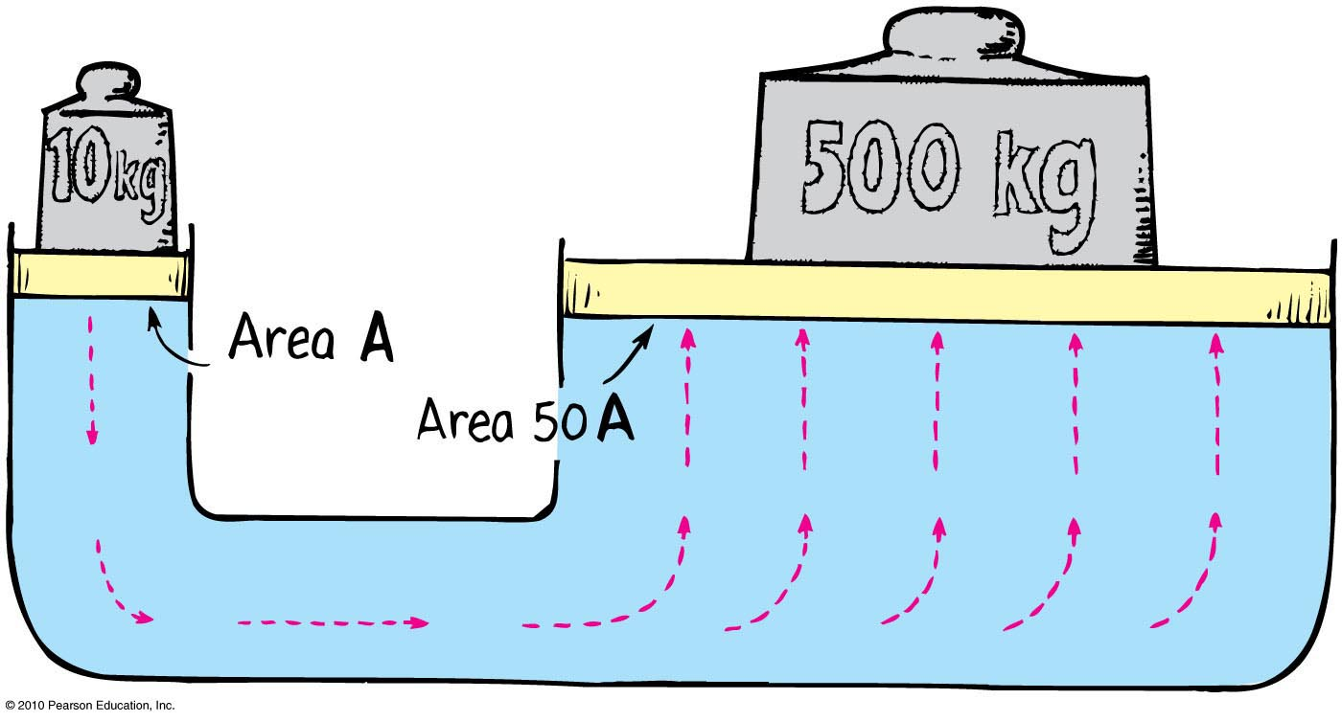
Pascal’s Principle
Application in hydraulic press
Example:
  Pressure applied to the left piston is transmitted to the right piston.
  A 10-kg load on small piston (left) lifts a load of 500 kg on large piston (right).

Slide 54
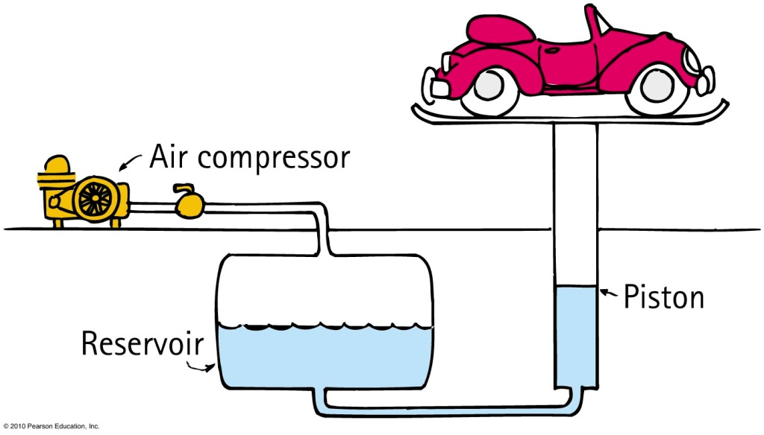
Pascal’s Principle
Application for gases and liquids:
  Seen in everyday hydraulic devices used in construction
  In auto lifts in service stations
    Increased air pressure produced by an air compressor is transmitted through the air to the
    surface of oil in an
    underground reservoir.
    The oil transmits the
    pressure to the piston,
    which lifts the auto.

Slide 55
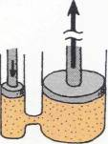
Chapter 13 Problem # 7
In the hydraulic pistons shown in the sketch, the small piston has a diameter of 2 cm. The larger piston has a diameter of 6 cm. How much more force can the larger piston exert compared with the force applied to the smaller piston?

Slide 56
In the hydraulic pistons shown in the sketch, the small piston has a diameter of 2 cm. The larger piston has a diameter of 6 cm. How much more force can the larger piston exert compared with the force applied to the smaller piston?
Pascal’s Principle sates that the force is proportional to the relative areas. The areas are as the proportional to the squares of the diameters;
F_{larger}/ F_{smaller} = 6²/2² = 36/4 = 9.
The larger piston can exert 9 times the force applied to the smaller piston.

Slide 57
Homework
Read Chapter 13 in Detail.
Do Ranking # 3
Do Exercises # 3, 7, 11,15, 35, 45, 47, 55
Do Problems # 5
Due: June 27

